Slide 1
The Last Battalion
Game of Words and Math Games 2022

Slide 2
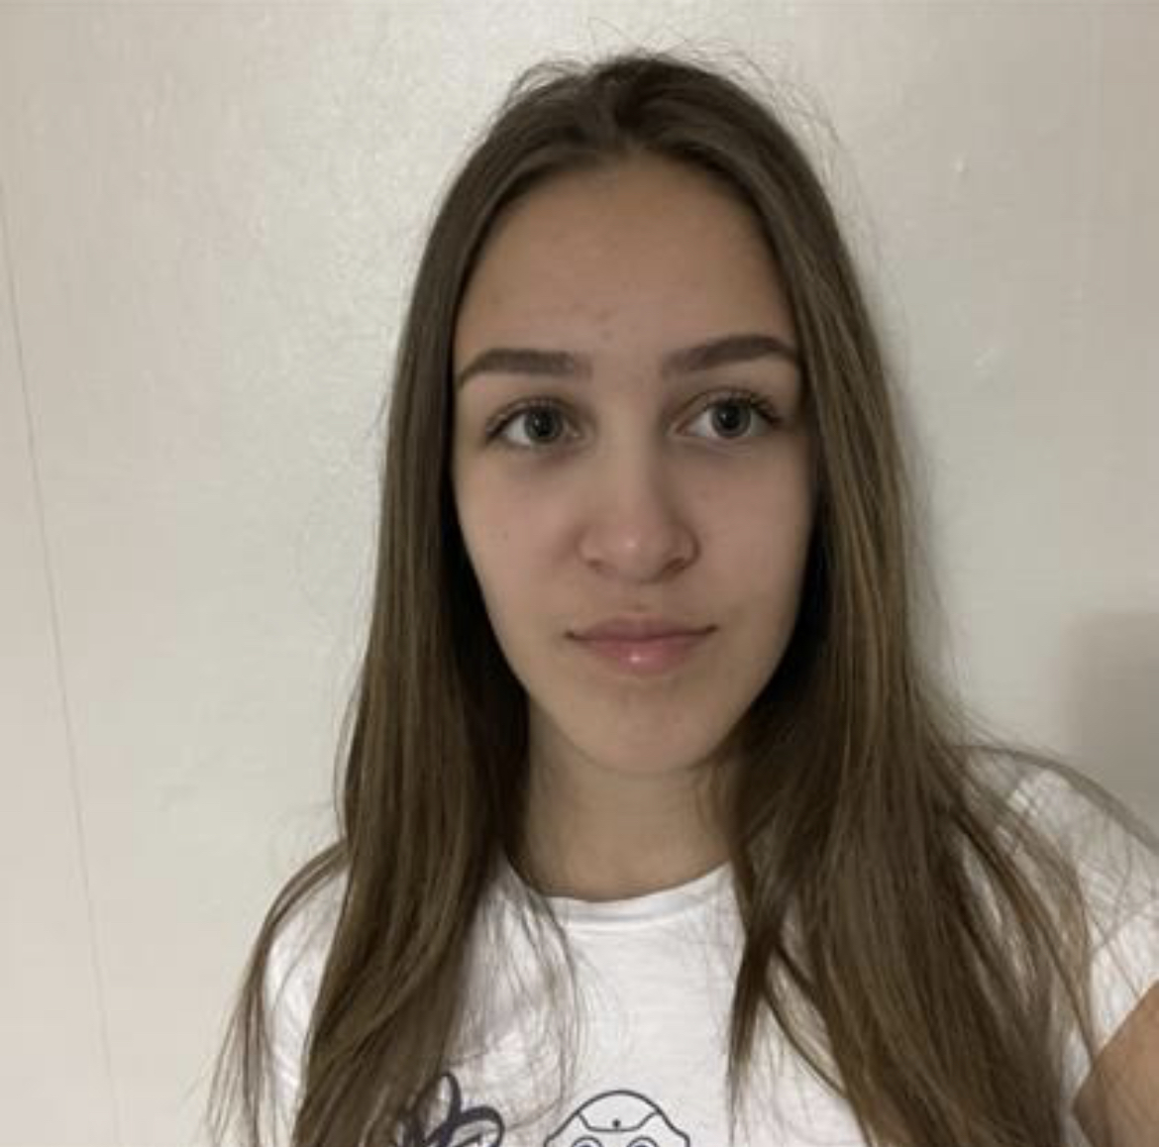
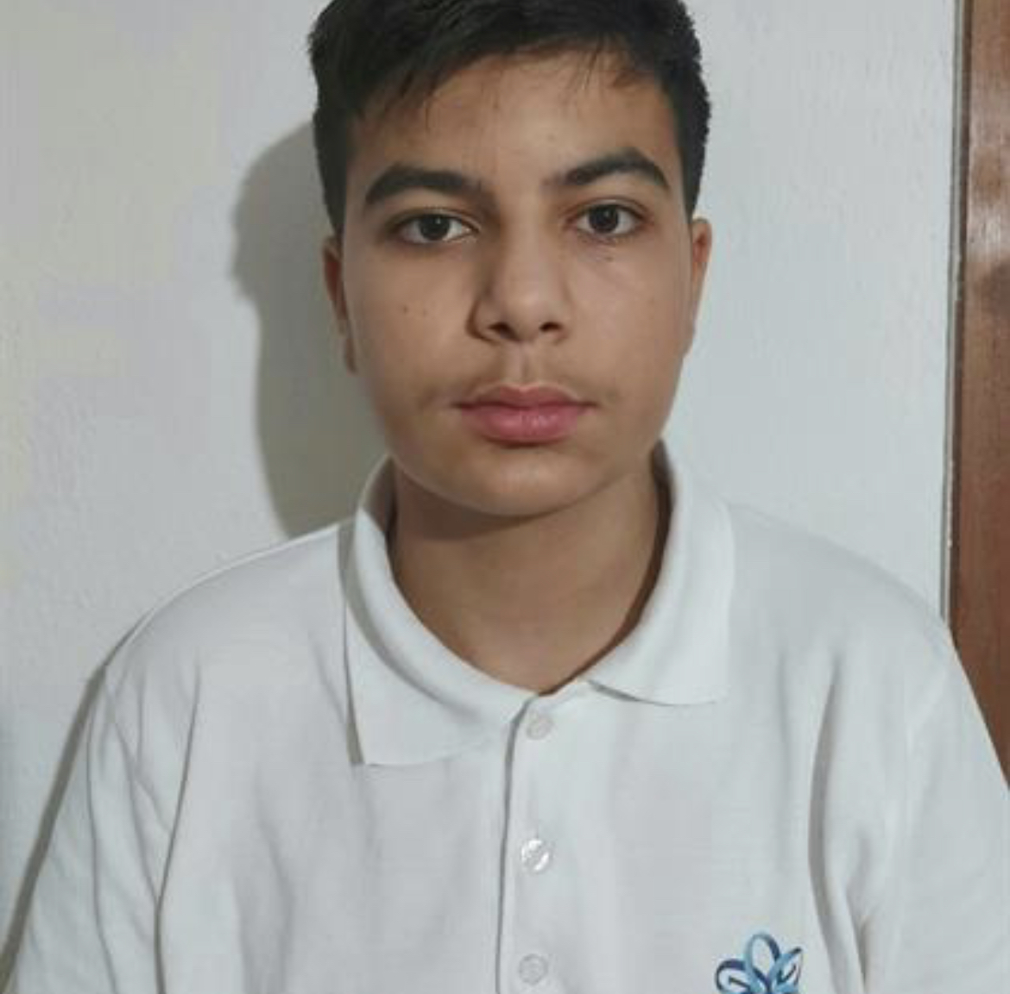
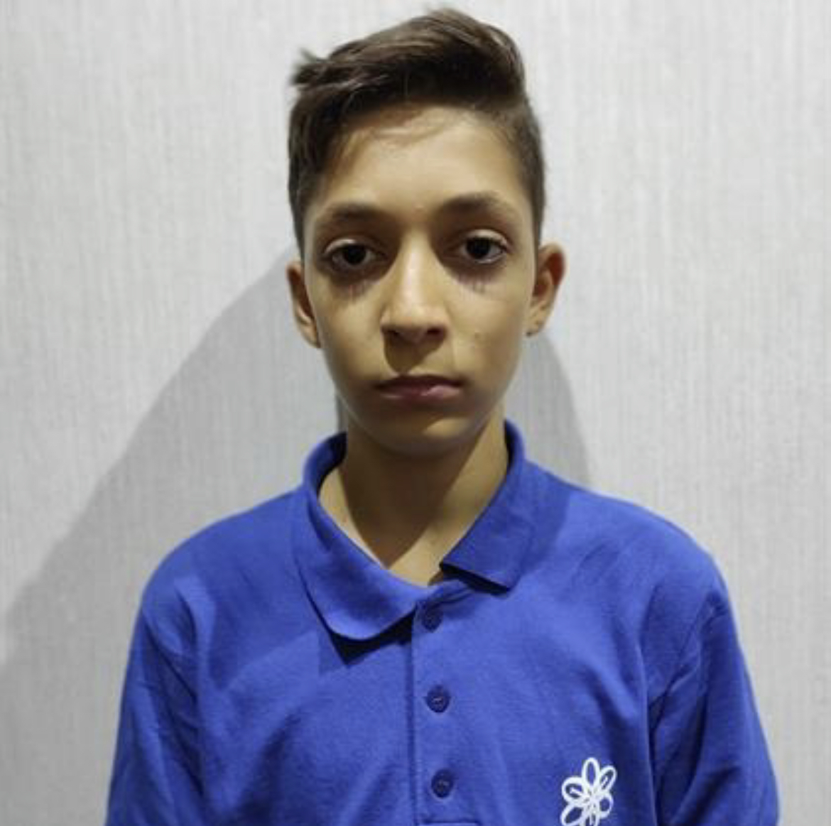
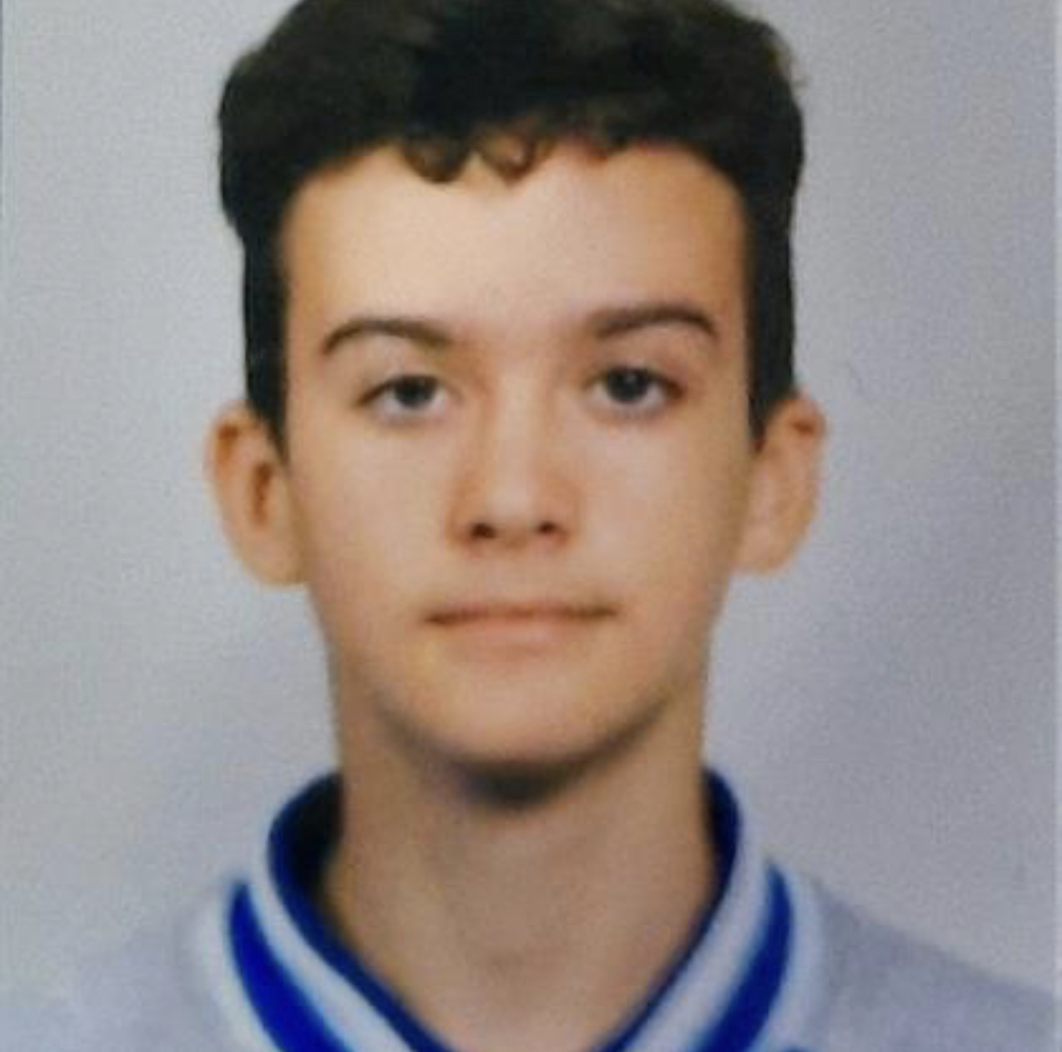
Our team
Ivayla Kuzmova
Scrum Trainer
Denis Yusein
Frontend Developer
Georgi Atanasov
Backend Developer
Daniel Busin
QA Engineer

Slide 3
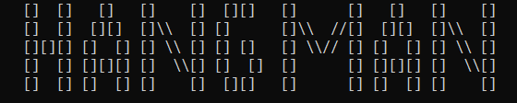
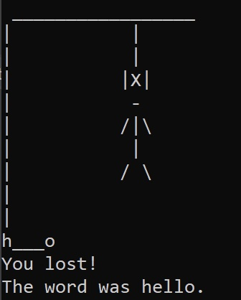
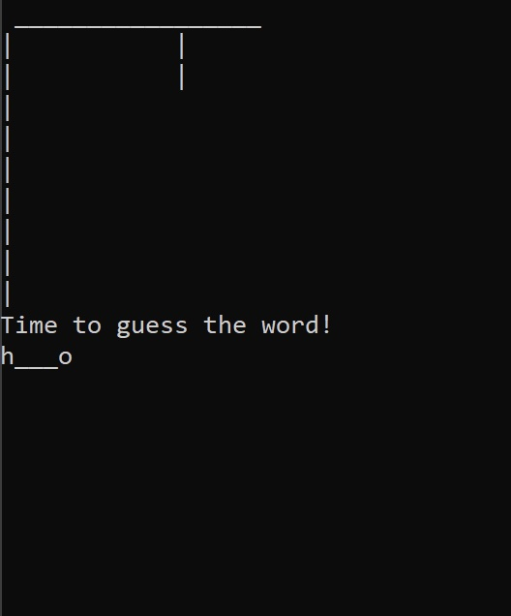
Our idea

Slide 4
Stages of development
Gave ideas
Wrote the code
Tested the game

Slide 5







The programs we used
CODE
LANGUAGE
COMMUNICATION
PLATFORM
PRESENTATION
DOCUMENTATION
QA DOCUMENTATION

Slide 6
LET’S JUMP TO THE PROJECT

